Slide 1


——————————————————————————————£°°°°°°°°°°°°°°°°°°°°°°°°°°°°°°°°°°°°°°°°°°°
ANALYSIS OF SOCIOL ECONOMIC FACTORS IN INDIAN CITIES,A COMPARATIVE STUDY OF DEVELOPMENT AND IT DEPENDENCY IN 100 CITIES
by NALIN KUMAR V

Slide 2


INTRODUCTION
This project focuses on analyzing and comparing various socioeconomic factors across Indian cities, with an emphasis on the distinction between developed and developing cities. By examining key metrics such as GDP, population, literacy rate, and IT dependency, the project seeks to uncover trends and insights that highlight the influence of these factors on urban development.

Slide 3
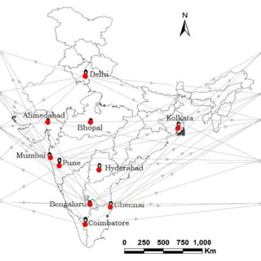

OBJECTIVE:
To analyze the differences in key factors such as GDP, literacy, population, and sex ratio between developed and developing cities in India.
Investigate the relationship between IT-dependency and these factors.
Key Variables:
IT-Dependency (1 = Yes, 0 = No)
Development Status (1 = Developed, 0 = Developing)
GDP Rate (in Billion $)
Population
Literacy Rate
Sex Ratio

Slide 4

DATASET OVERVIEW
1
Indian Cities
6
Population
2
Indian States
7
Literacy Rate
3
Development Status (1 = Developed, 0 = Developing)
8
Sex Ratio
4
IT-Dependency (1 = Yes, 0 = No)
9
Density(km)
5
GDP Rate (in Billion $)
10
Main Language

Slide 5
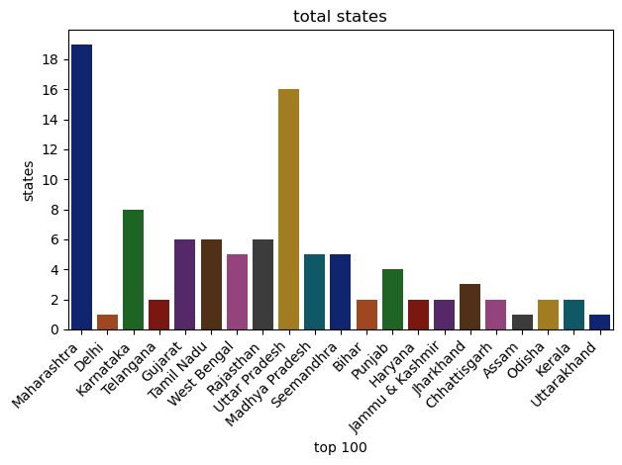
TOTAL CITIES IN STATES

Slide 6

Distribution of Cities
Number of developed vs. developing cities.
Percentage breakdown of IT-dependent vs non-IT-dependent cities.
Descriptive Statistics
EXPLORATORY DATA ANALYSIS
GDP, Population, Literacy, etc., for each category (Developed vs Developing).

Slide 7
ANOVA TEST BETWEEN IT-DEPENDENT (1=YES, 0=NO) AND LITERACY
Hypotheses
Null Hypothesis (H₀):reject the null hypothesis .
Alternative Hypothesis (H₁):Fail to reject the null hypothesis .
F-statistic: 4.754922351664507
P-Value: [0.031607981327304475
]
Conclusion: Based on the p-value, reject the null hypothesis
.

Slide 8
T-TEST FOR LITERCY BETWEEN DEVELOPED AND DEVELOPING CITIES
Hypothesis
Null Hypothesis:significant difference in population between developed and developing cities.
Alternative Hypothesis: There is a no significant difference in population.
T-Test Results:
T-Statistic: [1.6834372985035124]
P-Value: [0.0954735188633839]
Conclusion: Based on the p-value, fail reject the null hypothesis.

Slide 9
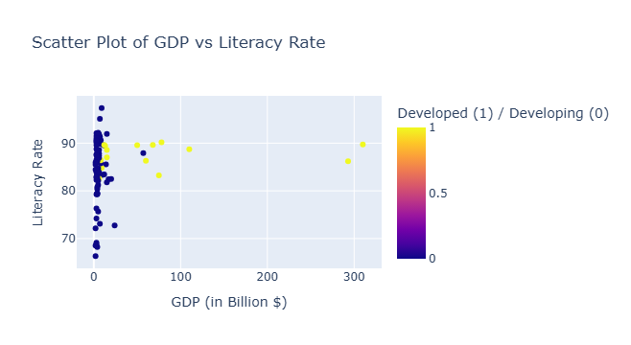
T-Test for GDP Between IT-Dependent and Non-IT-Dependent Cities
Hypothesis:
Null Hypothesis: significant difference in GDP between IT-dependent and non-IT-dependent cities.
Alternative Hypothesis: There is a no significant difference in GDP.
T-Test Results:
T-Statistic: [4.234934173728637]
P-Value: [5.163334042785814e-05]
Conclusion: Based on the p-value, we reject the null hypothesis.

Slide 10

T-Test: Populatiin in Developed vs Developing Cities
Content:
Hypothesis:
Null Hypothesis:significant difference in population
Alternative Hypothesis: no Significant difference in population.
T-Test Results:
T-Statistic: [6.960974372408111]
P-Value: [ 3.868680433174975e-10]
Conclusion: Based on the p-value, we reject the null hypothesis.

Slide 11
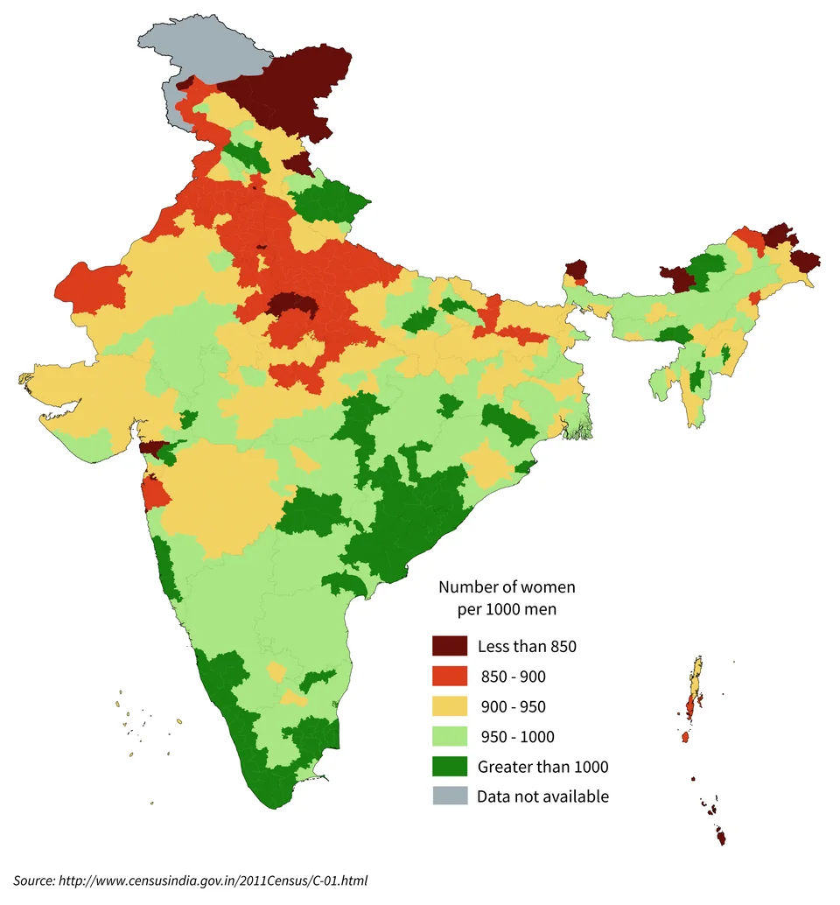
T-Test: Sex Ratio in Developed vs Developing Cities
Content:
Hypothesis:
Null Hypothesis: significant difference in sex ratio.
AlternativeHypothesis: no Significant difference in sex ratio.
T-Test Results:
T-Statistic: [-2.6023348287259793]
P-Value: [0.010695216932362153]
Conclusion: Based on the p-value, we reject the null hypothesis.

Slide 12
CONCLUSION
IT-Dependency has a significant impact on GDP.
Developed cities tend to have higher literacy rates and GDP.
There is a significant difference in population between developed and developing cities.
Minor differences observed in sex ratios.
IT-dependency and development status play a major role in shaping GDP, literacy rate, and population dynamics in cities.

Slide 13

THANK YOU
for your time and attention

